Slide 1
REPORT
Summary :
During testing on testasp.vulnweb.com, a Cross-Site Scripting (XSS) vulnerability was identified in an input field. When injecting the payload "<scrip</script>t><img src =q onerror=prompt(8)>" into the input box, the website reflects this input back to the user without proper sanitization or encoding.
Steps to Reproduce :
Navigate to the Website:
Open a web browser and go to the URL: testasp.vulnweb.com.
Locate the Input Field:
Identify an input field or form on the website where user input is reflected back to the page without proper sanitization.
Inject Payload:
Enter the following payload into the identified input field:
" <scrip</script>t><img src =q onerror=prompt(8)> “
Submit or Process the Input:
Submit or process the input field to trigger the server's response.
Observe the Result:
After submitting the input, observe the webpage for any unexpected behavior or pop-up dialogs.

Slide 2
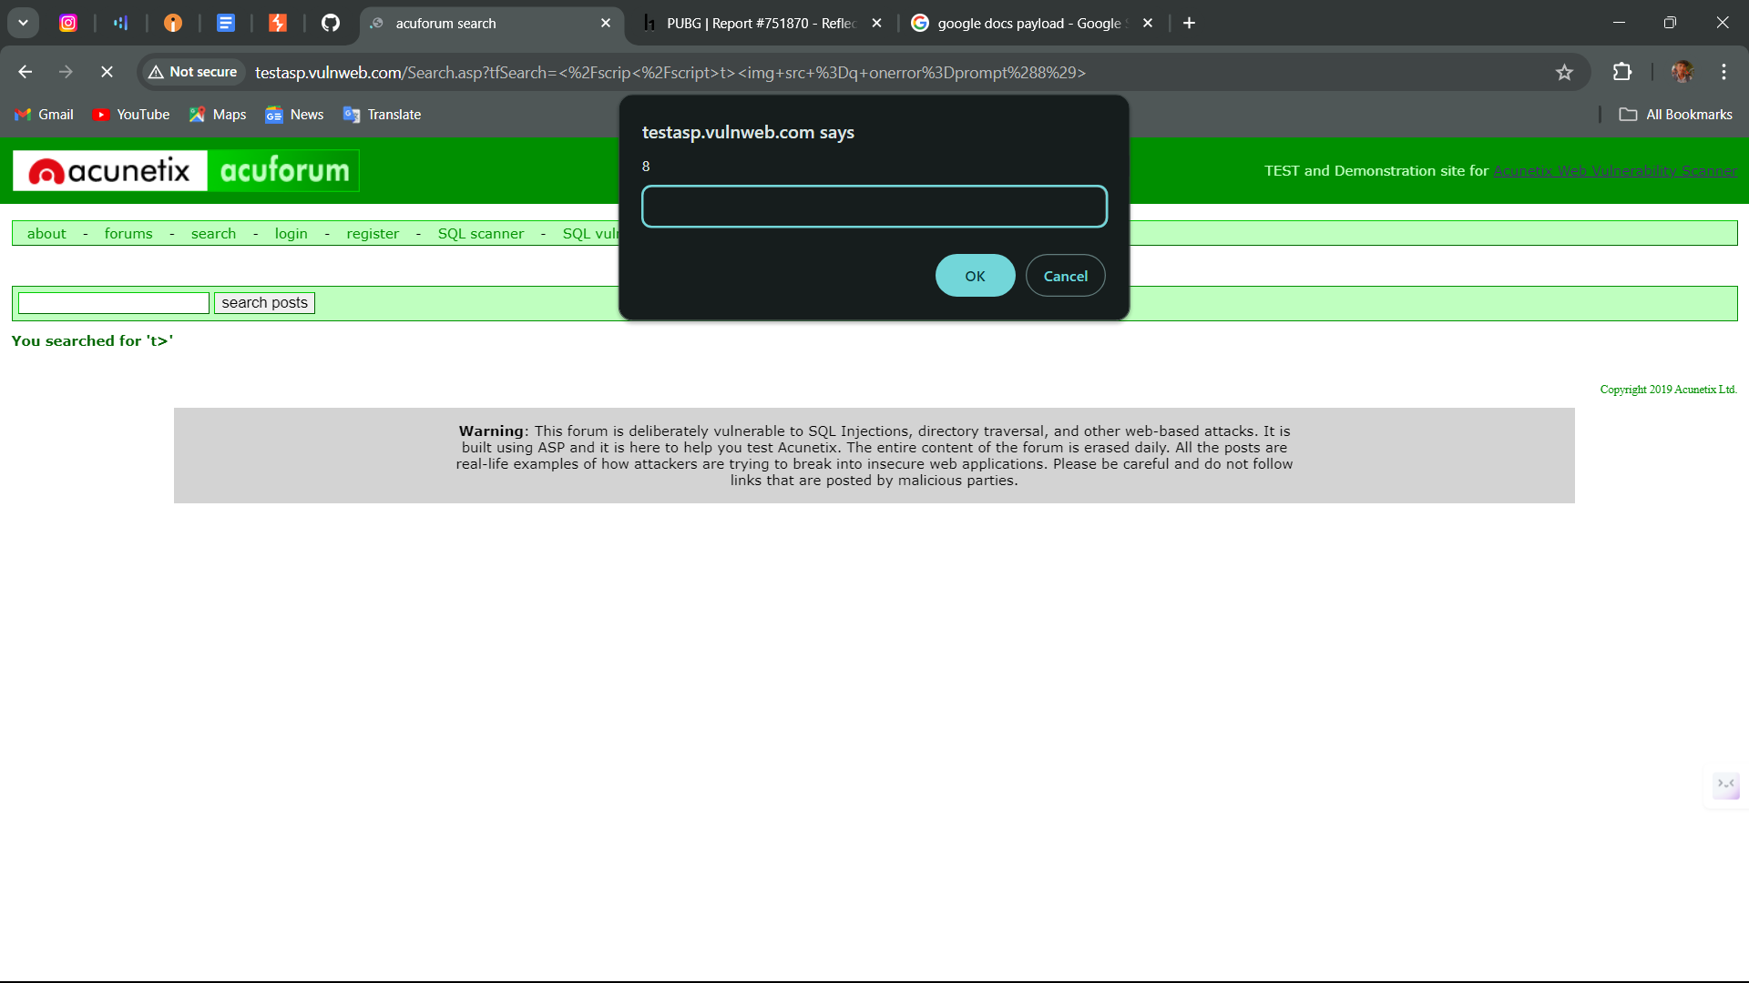
Verification of XSS:
If a pop-up dialog box appears displaying the number "8", it confirms the presence of a Cross-Site Scripting (XSS) vulnerability. This indicates that the injected JavaScript (prompt(8)) executed successfully in the context of the web page.
POC :
Image :

Slide 3
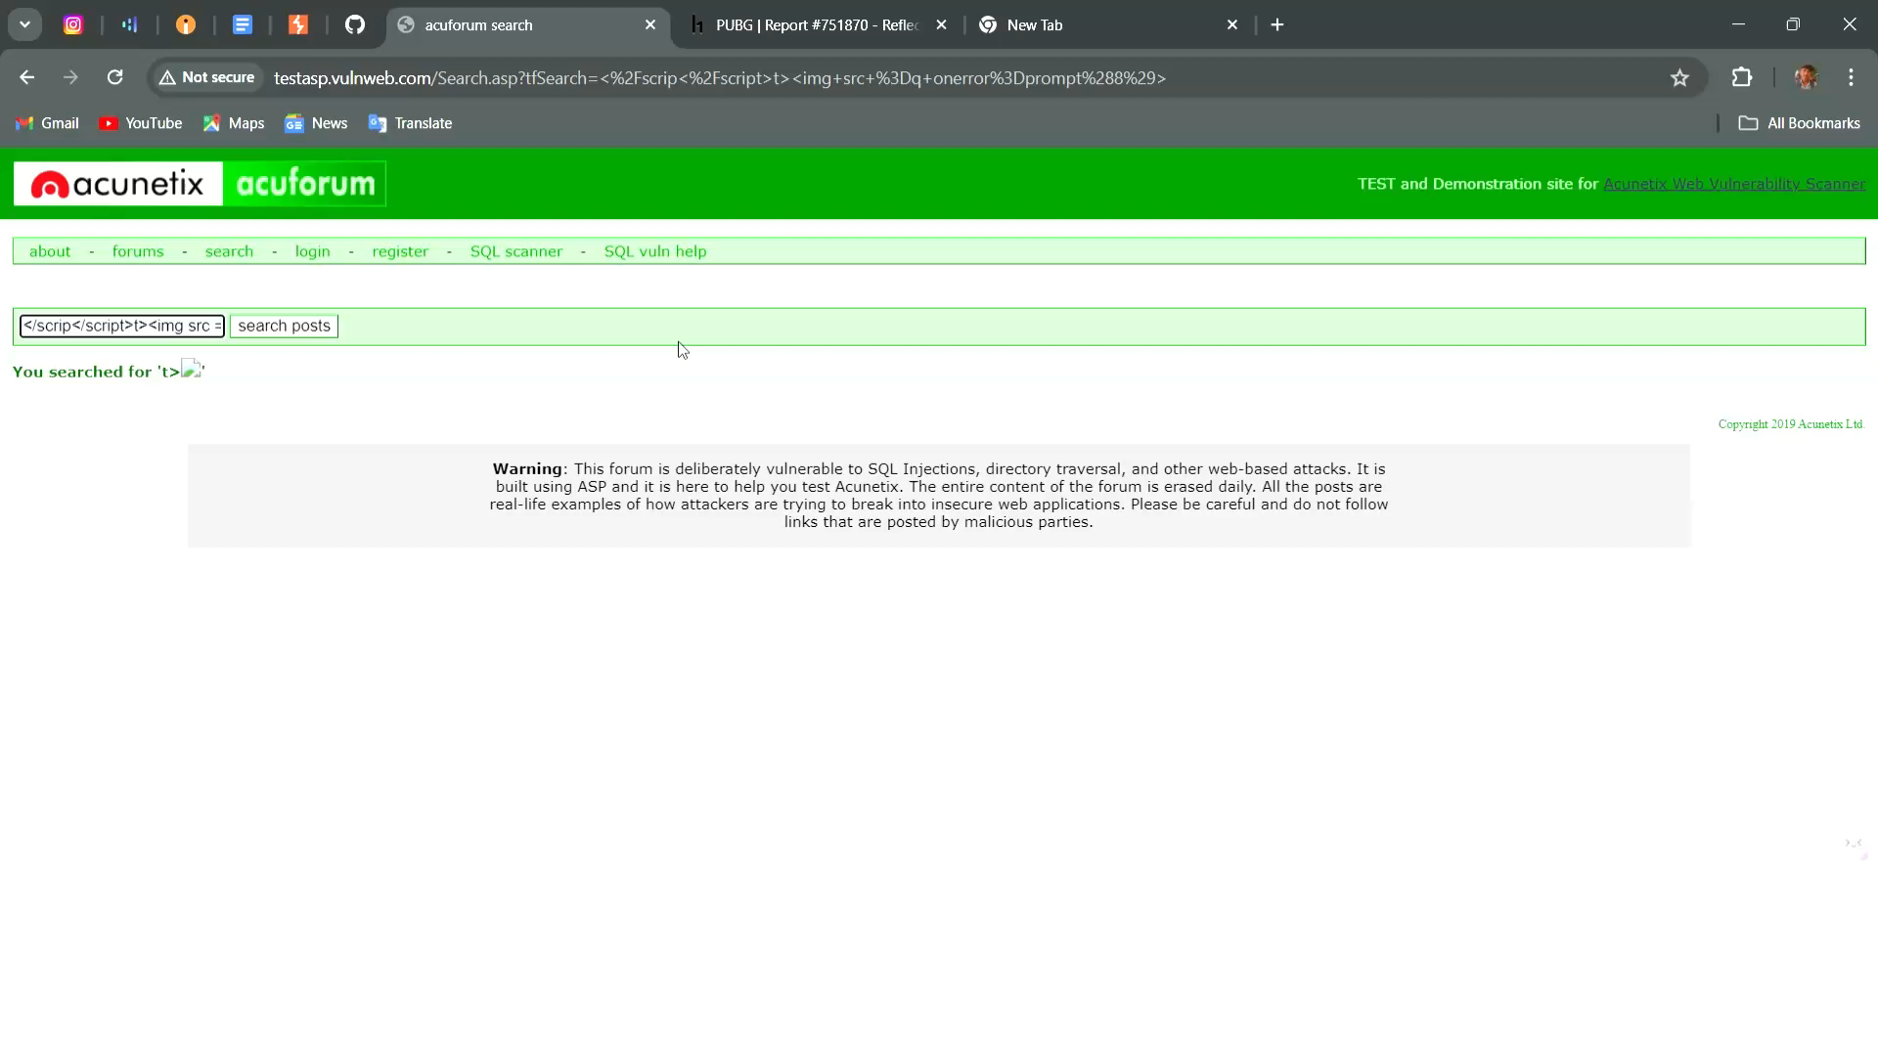
Video :
Impact :
Client-Side Execution: Allows arbitrary JavaScript (prompt(8)) execution in users' browsers.
Malicious Actions: Potential for session hijacking, data theft, and content manipulation.
User Trust: Risks user trust and website reputation.
Legal Consequences: Non-compliance with data protection regulations.
Operational Impact: Requires urgent mitigation and security measures.

